Slide 1
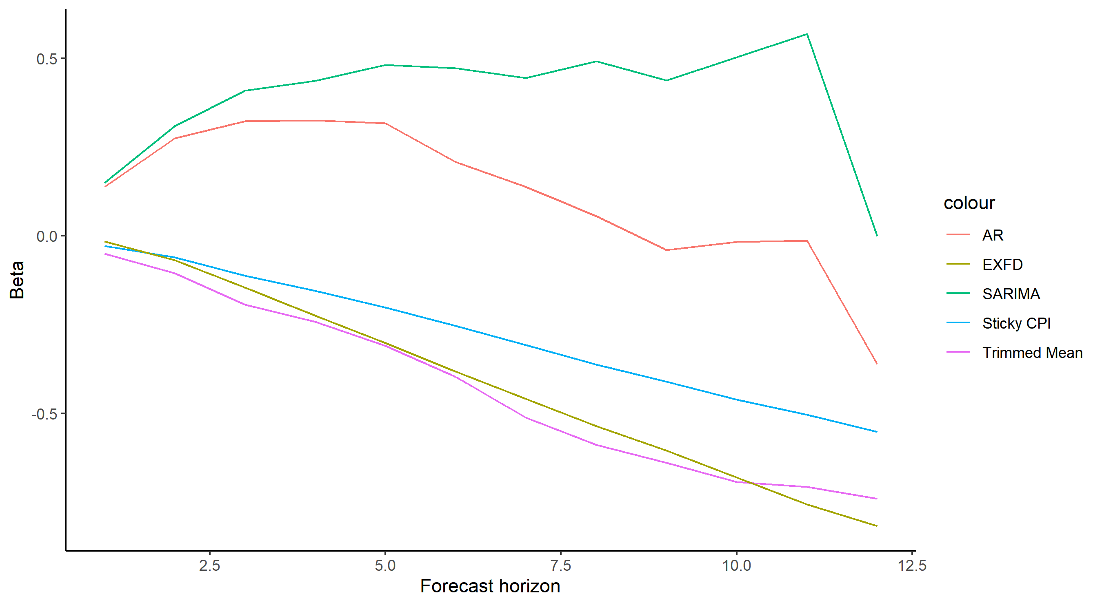

Slide 2
0.5
colour
0.0
AR
Beta
EXFD
SARIMA
Sticky CPI
Trimmed Mean
-0.5
2.5
5.0
7.5
10.0
12.5
Forecast horizon

